Slide 1
PRESENTED BY : Shiloh JSH
REGISTER NO : 730321243023
DEPARTMENT : Artificial Intelligence and data Science
3/21/2024 Annual Review

Slide 2
PROJECT TITLE
VIDEO COLORIZER USING AI-DEEP LEARNING TECHNIQUE
3/21/2024 Annual Review

Slide 3


AGENDA
Problem Statement
Project Overview
Who are the end users?
Your solution and its value proposition
The wow in your solution
Modelling
Results

Slide 4

PROBLEM STATEMENT
The project aims to address the challenge of enhancing the visual quality and emotional impact of historical or monochrome videos by developing an AI-powered video colorization solution. The lack of color in such videos diminishes their appeal and hampers their ability to resonate with viewers. Existing manual colorization techniques are time-consuming and often produce unsatisfactory results. Therefore, the project seeks to leverage deep learning and AI algorithms to automatically and accurately colorize grayscale videos, preserving the authenticity of the original content while enhancing its visual richness.

Slide 5

PROJECT OVERVIEW
Grayscale videos lack the vibrancy and visual appeal of color videos, making them less engaging and aesthetically pleasing. Manual colorization of videos is a time-consuming and labor-intensive process, often requiring skilled artists to meticulously add colors frame by frame. This project aims to automate and streamline the video colorization process using artificial intelligence (AI) and deep learning techniques. The primary objective of this project is to develop a robust and efficient system capable of automatically adding realistic and vibrant colors to grayscale videos. By harnessing the power of AI and deep learning, the system will analyze the content of grayscale videos and intelligently predict appropriate colors for each frame, resulting in visually appealing colorized videos.

Slide 6

WHO ARE THE END USERS?
Filmmakers and Video Editors
Content Creators
Archivists and Historians
Educators and Researchers
General Public
Film Enthusiasts

Slide 7

YOUR SOLUTION AND ITS VALUE PROPOSITION
SOLUTION:
Develop an AI-powered deep learning model trained on large datasets to automatically colorize grayscale videos.Implement temporal coherence techniques to ensure smooth transitions and consistency between frames.Provide a user-friendly interface for customization and control, enabling filmmakers, content creators, and historians to efficiently produce high-quality colorized videos.
VALUE PROPOSITION:
Save Time and Effort: Automating the colorization process reduces the time and effort required to manually add colors to grayscale videos, enabling users to produce high-quality colorized content more efficiently.Enhance Visual Quality: By leveraging AI and deep learning techniques, the colorizer enhances the visual quality of videos, making them more vibrant and appealing to viewers. This can improve engagement and retention among audiences.

Slide 8

THE WOW IN YOUR SOLUTION
Instantly transform grayscale videos into vibrant, colorized masterpieces with unparalleled realism.Seamlessly maintain temporal coherence for smooth transitions between frames, ensuring a visually captivating viewing experience.Empower users with customizable options to unleash their creativity and achieve their desired aesthetic effortlessly.
8

Slide 9
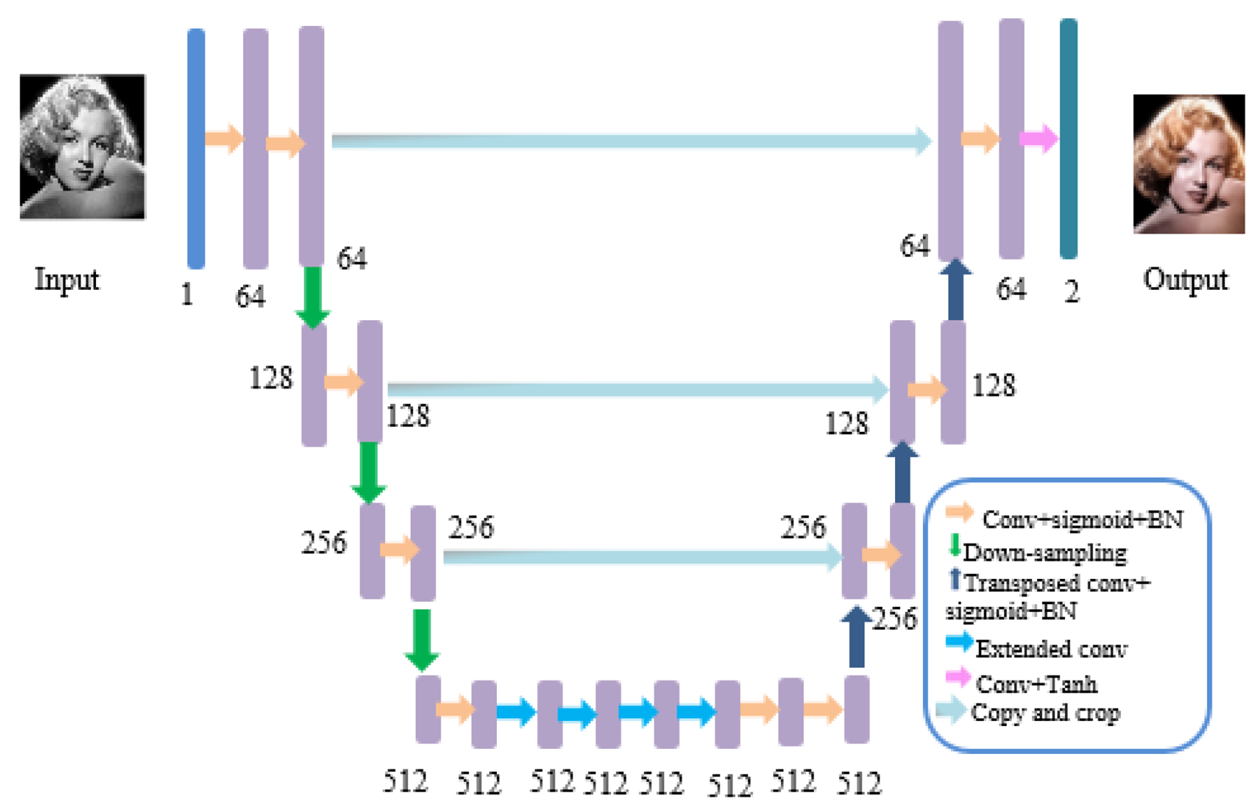
MODELLING
9

Slide 10
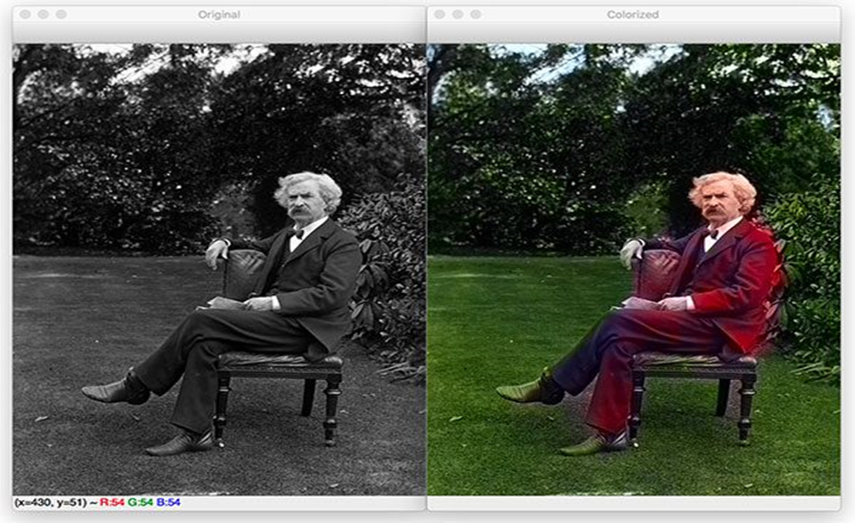
RESULTS
.
Our project results in a sophisticated video colorization system that effortlessly transforms grayscale videos into vivid, lifelike representations with remarkable accuracy. By harnessing advanced AI and deep learning techniques, it offers users an intuitive and efficient tool to enhance the visual appeal of their content, setting new standards in video processing and restoration.
Demo Link:https://github.com/Shiloh-1973/TNSDC.git
10

